Slide 1
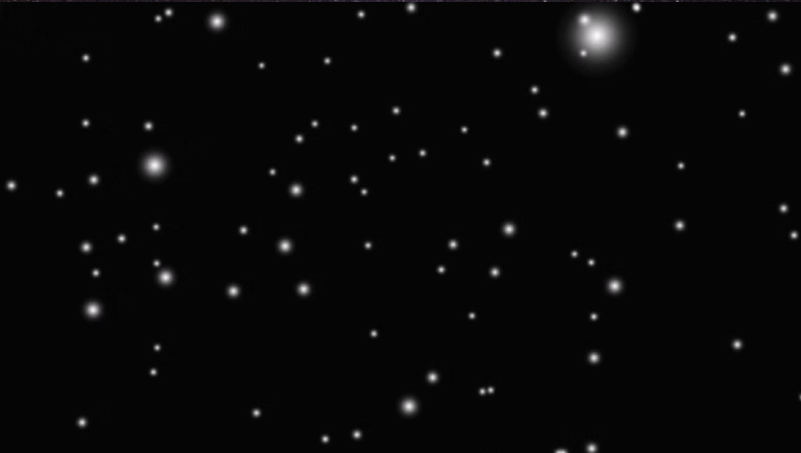



Calibration
Inter-trial interval
Imagine running
Stop
Inter-trial interval
Relax

Slide 2

Train classifier
Class A
Class B

Slide 3
Classify online
Increase starfield velocity
Decrease starfield velocity

Slide 4

Experimental paradigm
Instruction (until keypress)
Imagine movement
Continues for 8, 18 or 30 s)
Stop
How long was the starfield shown?
20 s
5 ___|__________80
How fast did time seem to pass?
very very slow________|___fast

Slide 5

Neuroadaptation (cybernetic control)
State classified: ‘run’
Velocity
State memory:
‘walk;run;run’
→ Majority vote: ‘run’
max
min
min max
If condition is ‘neuroadaptive’ increase velocity:
Velocity is mapped to an exponential function with N levels between minimum movement / s and maximum movement / s.
Velocity

Slide 6
Testing neuroadaptive device against control
Recorded classifier replay: plays back classifier output of previous trial
Effect of imagery without neuroadaptivity: play back recording from previous ‘run’ task while participant merely relaxes.
Effect of online neuroadaptivity: play back recording from previous ‘run’ task while participant actively imagines running.
Non-adaptive controls: static starfield without adjustments
Effect of seeing online adjustments in speed: no adjustments of starfield while participant actively imagines running.
Complete baseline: no adjustments of starfield while participant merely relaxes.

